Slide 1
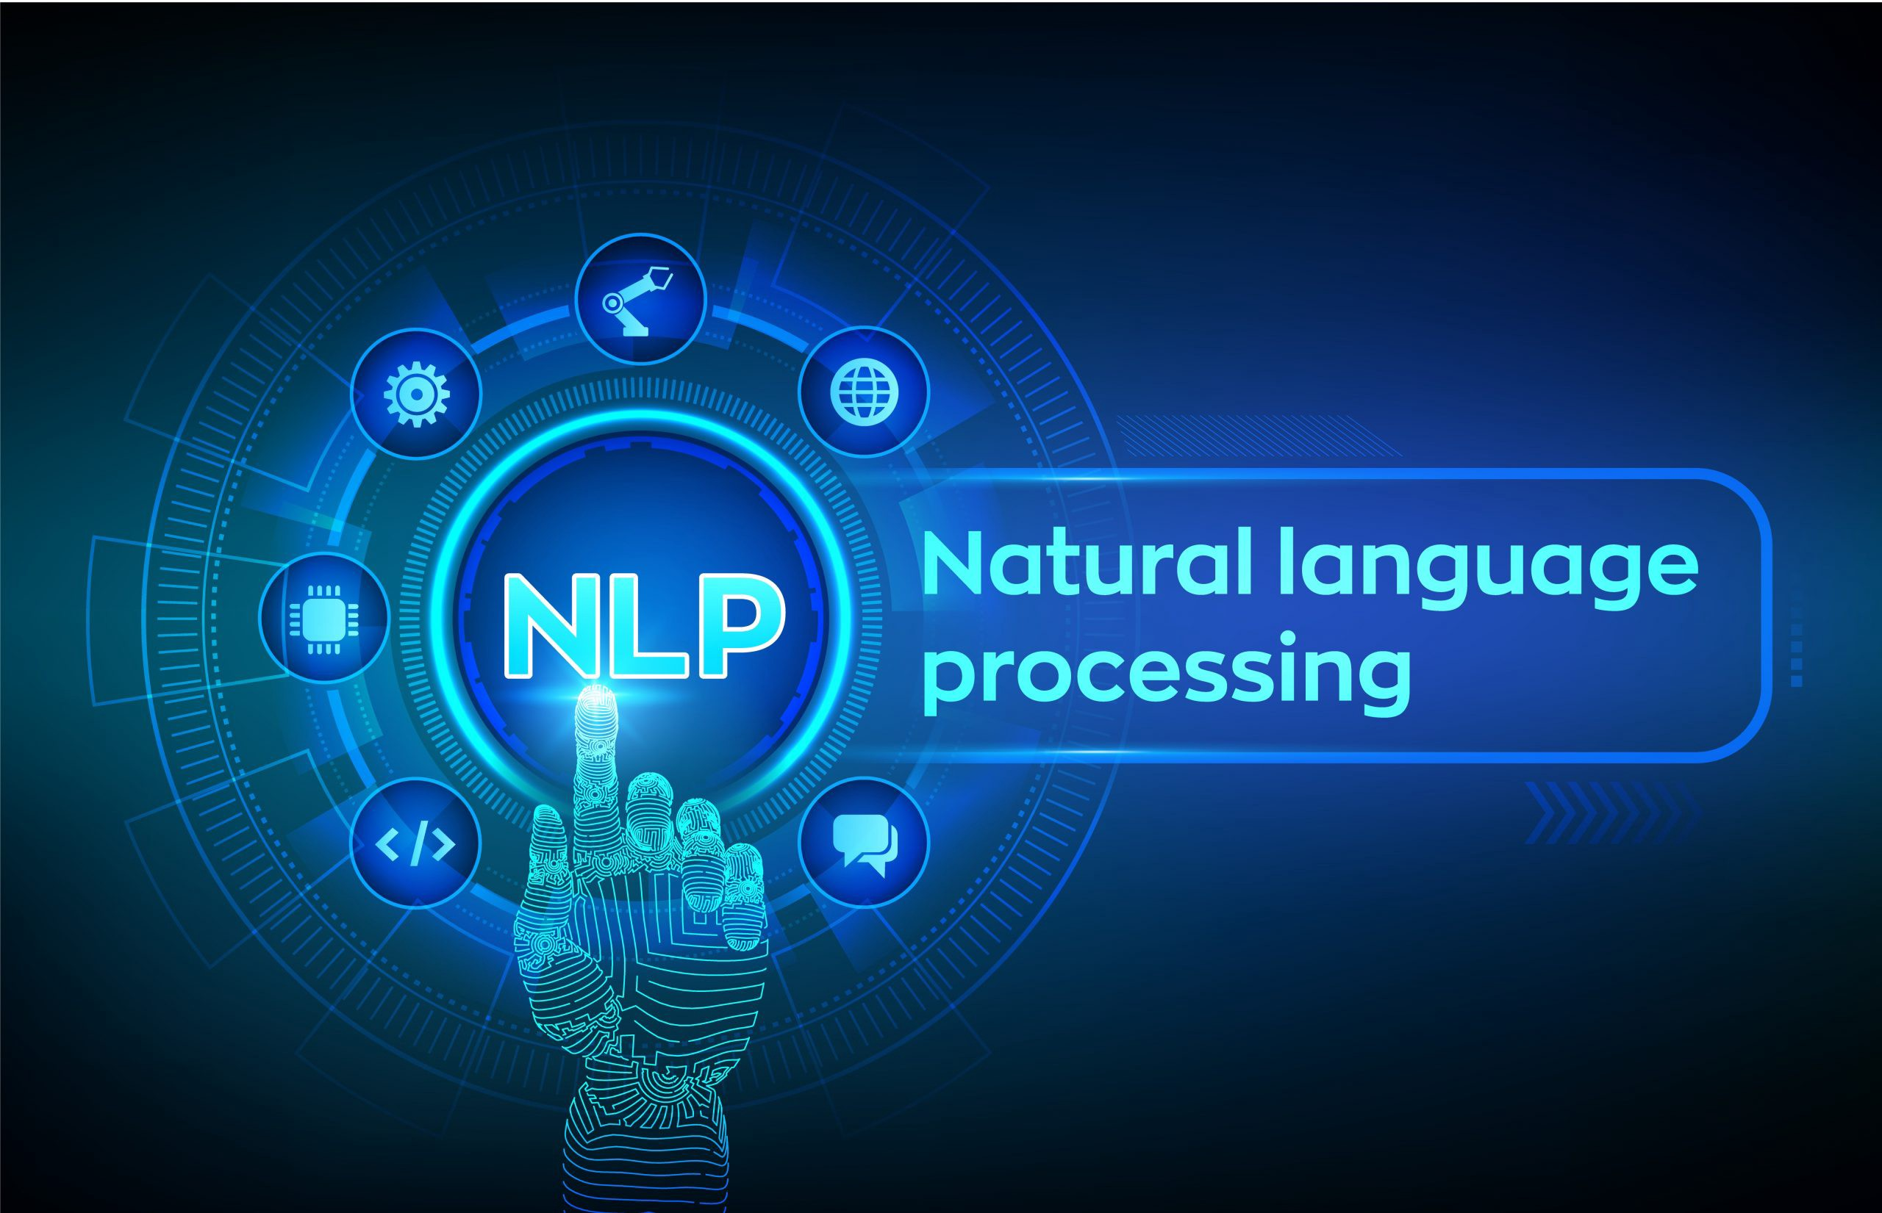
The lecture 8
Stemming and lemmatization

Slide 2
Stemming
The process of stemming requires understanding what word stems represent.
We looked at morphemes, the smallest independent unit in any natural language. Morphemes consist of units that are stems and affixes.
Affixes are units like prefixes, suffixes, and so on, which are attached to a word stem to change its meaning or create a new word altogether.
Word stems are also often known as the base form of a word, and we can create new words by attaching affixes to them in a process known as inflection .
The reverse of this is obtaining the base form of a word from its inflected form, and this is known as stemming .
Consider the word JUMP . You can add affixes to it and form new words like JUMPS, JUMPED, and JUMPING .
In this case, the base word JUMP is the word stem. If we were to carry out stemming on any of its three inflected forms, we would get back the base form.

Slide 3
Word stem and inflections
The figure shows how the word stem is present in all its inflections since it forms the base on which each inflection is built upon using affixes.
Stemming helps us in standardizing words to their base stem irrespective of their inflections, which helps many applications like classifying or clustering text, and even in information retrieval.
Search engines make use of such techniques extensively to give better and more accurate results irrespective of the word form.

Slide 4
Stemmers
The nltk package has several implementations for stemmers.
These stemmers are implemented in the stem module, which inherits the StemmerI interface in the nltk.stem.api module.
You can even create your own stemmer using this class (technically it is an interface ) as your base class.
One of the most popular stemmers is the Porter stemmer, which is based on the algorithm developed by its inventor, Dr. Martin Porter.
Originally, the algorithm is said to have had a total of five different phases for reduction of inflections to their stems, where each phase has its own set of rules.
There also exists a Porter2 algorithm, which was the original stemming algorithm with some improvements suggested by Dr. Porter.

Slide 5
Stemmers
# Porter Stemmer
In [458]: from nltk.stem import PorterStemmer
...: ps = PorterStemmer()
In [459]: print ps.stem('jumping'), ps.stem('jumps'), ps.stem('jumped')
jump jump jump
In [460]: print ps.stem('lying')
lie
In [461]: print ps.stem('strange')
strang

Slide 6
Stemmers
The Lancaster stemmer is based on the Lancaster stemming algorithm, also often known as the Paice/Husk stemmer, invented by Chris D. Paice.
This stemmer is an iterative stemmer that has over 120 rules specifying specific removal or replacement for affixes to obtain the word stems.
# Lancaster Stemmer
In [465]: from nltk.stem import LancasterStemmer
...: ls = LancasterStemmer()
In [466]: print ls.stem('jumping'), ls.stem('jumps'), ls.stem('jumped')
jump jump jump
In [467]: print ls.stem('lying')
lying
In [468]: print ls.stem('strange')
strange

Slide 7
Stemmers
You can see that the behavior of this stemmer is different from the Porter stemmer.
There are several other stemmers, including RegexpStemmer , where you can build your own stemmer based on user-defined rules , and SnowballStemmer , which supports stemming in 13 different languages besides English.
The following code snippet shows some ways of using them for performing stemming.
The RegexpStemmer uses regular expressions to identify the morphological affixes in words, and any part of the string matching the same is removed:
# Regex based stemmer
In [471]: from nltk.stem import RegexpStemmer
...: rs = RegexpStemmer('ing$|s$|ed$', min=4)
In [472]: print rs.stem('jumping'), rs.stem('jumps'), rs.stem('jumped')
jump jump jump
In [473]: print rs.stem('lying')
ly
In [474]: print rs.stem('strange')
strange

Slide 8
Stemmers
You can see how the stemming results are different from the previous stemmers and are based completely on our custom-defined rules based on regular expressions.
The following snippet shows how to use the SnowballStemmer to stem words in other languages
# Snowball Stemmer
In [486]: from nltk.stem import SnowballStemmer
...: ss = SnowballStemmer("german")
In [487]: print 'Supported Languages:', SnowballStemmer.languages
Supported Languages: (u'danish', u'dutch', u'english', u'finnish',
u'french', u'german', u'hungarian', u'italian', u'norwegian', u'porter',
u'portuguese', u'romanian', u'russian', u'spanish', u'swedish')
# stemming on German words
# autobahnen -> cars
# autobahn -> car
In [488]: ss.stem('autobahnen')
Out[488]: u'autobahn'
# springen -> jumping
# spring -> jump
In [489]: ss.stem('springen')
Out[489]: u'spring'

Slide 9
Lemmatization
The process of lemmatization is very similar to stemming—you remove word affixes to get to a base form of the word.
In this case, this base form is also known as the root word , but not the root stem . The difference is that the root stem may not always be a lexicographically correct word; that is, it may not be present in the dictionary.
The root word, also known as the lemma , will always be present in the dictionary.
The lemmatization process is considerably slower than stemming because an additional step is involved where the root form or lemma is formed by removing the affix from the word if and only if the lemma is present in the dictionary.

Slide 10
Lemmatization
The nltk package has a robust lemmatization module that uses WordNet and the word’s syntax and semantics, like part of speech and context, to get the root word or lemma.
There were mainly three entities—nouns, verbs, and adjectives—that occur most frequently in natural language.
In [514]: from nltk.stem import WordNetLemmatizer
...: wnl = WordNetLemmatizer()
# lemmatize nouns
In [515]: print wnl.lemmatize('cars', 'n')
...: print wnl.lemmatize('men', 'n')
car
men

Slide 11
Lemmatization
# lemmatize verbs
In [516]: print wnl.lemmatize('running', 'v')
...: print wnl.lemmatize('ate', 'v')
run
eat
# lemmatize adjectives
In [517]: print wnl.lemmatize('saddest', 'a')
...: print wnl.lemmatize('fancier', 'a')
sad
fancy

Slide 12
Lemmatization
The preceding snippet shows how each word is converted back to its base form using lemmatization. This helps us in standardizing words.
The preceding code leverages the WordNetLemmatizer class , which internally uses the morphy() function belonging to the WordNetCorpusReader class.
This function basically finds the base form or lemma for a given word using the word and its part of speech by checking the Wordnet corpus and uses a recursive technique for removing affixes from the word until a match is found in WordNet.
If no match is found, the input word itself is returned unchanged.

